Slide 1
OneDot Data Processing
Last Update: 08/08/2021
Marcos Gomez-España Pecker

Slide 2
Table of Contents
1. Introduction
2. Key Facts of Input/Output
3. Summary of Changes to Input Data
4. Summary of Potential Changes
5. Take Away Message
Marcos Gomez-España Pecker

Slide 3
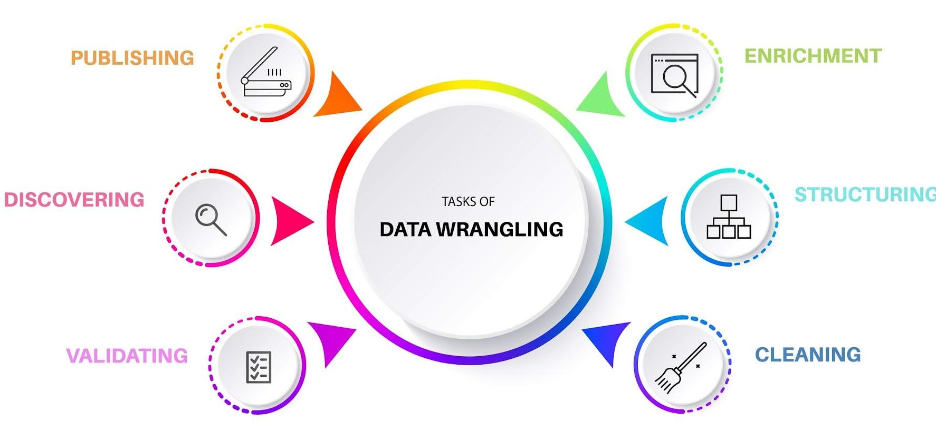
Introduction
1
Data processing at OneDot is quick and effective. We will discuss the processing of data, the list of changes we did and the list of potential changes we could do to improve this process. Lastly, we will talk about some changes the customer can apply to help refine the whole process.
Marcos Gomez-España Pecker

Slide 4
Key facts of Input/Output
2
Number of Attributes: The number of attributes of the incoming data is free, however only a certain number of columns will be used.
Missing Values: If there are missing values in the dataset or after the data wrangling, these will be managed in a way that it doesn’t affect the customer. We will fill with value “null” so the process stays error-free.
1
3
2
Number of Records: The number of record will maintain the same throughout the whole process. The records of the same product will be grouped so a unique way to identify products is needed.
4
Final output: The final output will have always the same number of columns (18).
Marcos Gomez-España Pecker

Slide 5
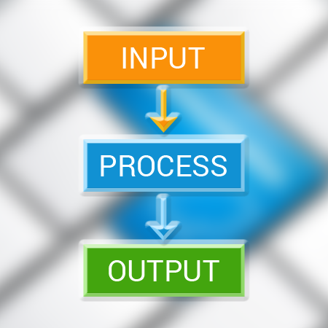
Key Facts of Input/Output – Number of Attributes
2
The data supplied has 9 attributes at first, however, the data can be pivoted so the values in the “Attribute Names” are also attributes. When this process is done (preprocessing), the data will have 25.
However, not all these attributes will be useful, and some needed attributes are missing. For instance, “Co2EmissionText”, “Ccm” or “Hp” amongst others are not needed and we don’t have information about the “price on request”, “driver” and “currency” attributes.
Marcos Gomez-España Pecker

Slide 6
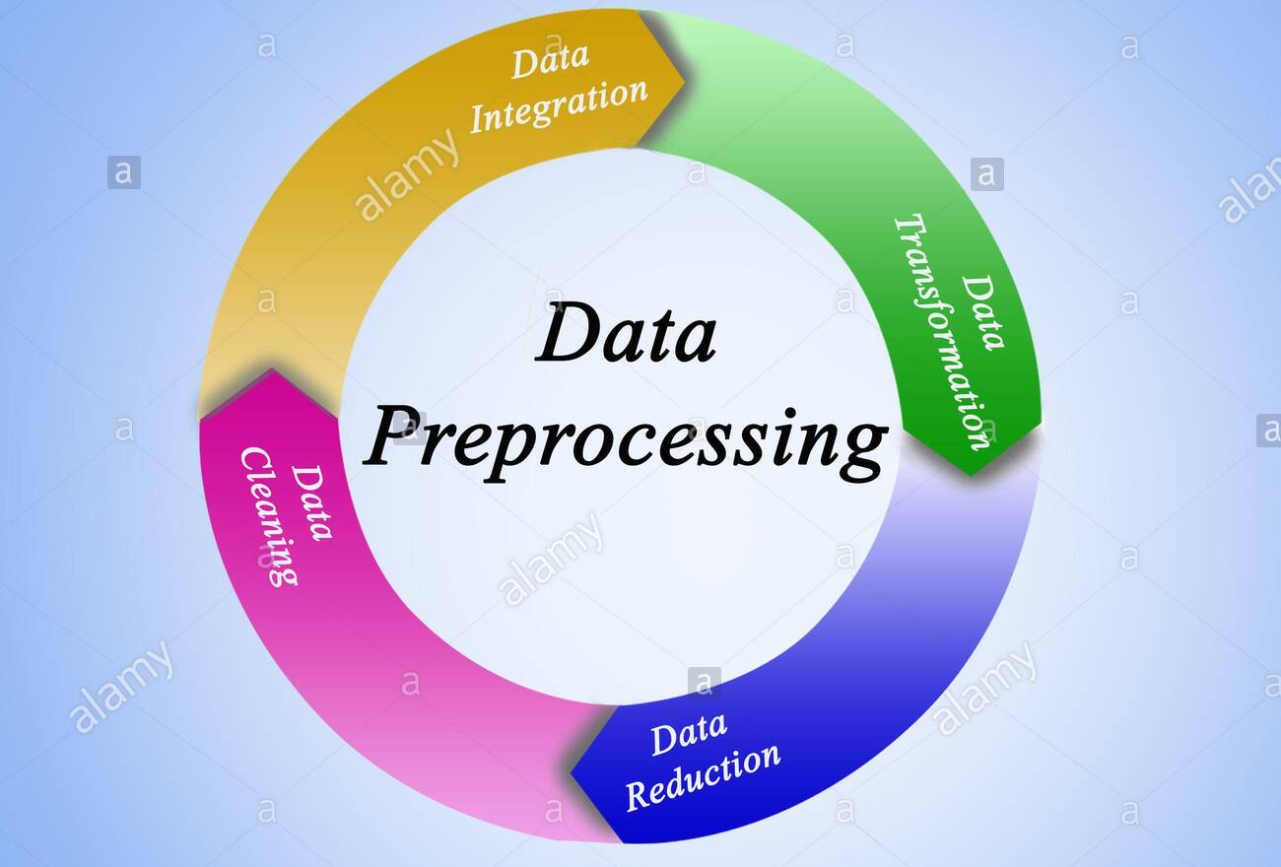
Key Facts of Input/Output – Number of Records
2
The way the original data is organized is by having one row for each attribute a product has. When we preprocess the data, we group by “ID” so that we end up having one record for each product.
Thus, although the number of rows changes, the number of distinct products maintains the same and all the information is preserved throughout the process.
Marcos Gomez-España Pecker

Slide 7
Summary of Changes to Input Data
3
1. Loading Data
3. Translation
5. Integration
2. Pre-Processing
4. Normalization
First, we load the data from the json file into a pandas DataFrame. We process the data using python and pandas.
In this step, data is translated to English. For this step to work we need a json with the translations. If needed, a API call to google could translate the texts needed
We discard not wanted columns and maintain those we need. Finally we export the processed data into a excel file
Load Data
Pre-Processing
Translation
Normalization
Integration
Second, we preprocess the data by unstacking column values into new columns. By this, we achieve the same granularity we need for the output file.
Here we rename the columns, cast them to the correct type and apply any function needed to the data in order to obtain the desired end results
Marcos Gomez-España Pecker

Slide 8

Summary of Potential Changes - Loading Data
4
When loading data, one change we could implement is the possibility of using databases as a source instead of plain .json files. This would help the scaling of the data and help relate data from different tables.
Moreover, if databases are used, we could automatically and periodically run the script to generate the desired output without the need of running it manually.
Marcos Gomez-España Pecker

Slide 9

Summary of Potential Changes - Translation
4
We could use a API called Google Translate Ajax API to translate all the texts without using a lookup table. By doing this, the whole data could be in another language, not only in german.
Marcos Gomez-España Pecker

Slide 10

Summary of Potential Changes - Exporting
4
Data can be exported to whatever format is needed. As well as exporting it to excel, we can export this data to a given database
Marcos Gomez-España Pecker

Slide 11
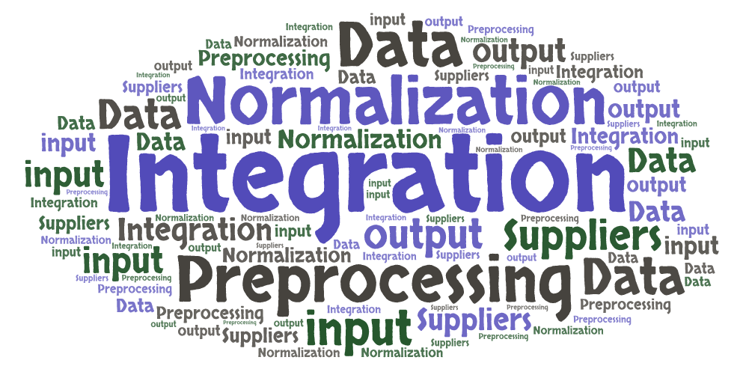
Take Away Message
5
We can effectively process data from other suppliers, however, because we need to meet a certain format, we need some data in particular and data not meeting the final format is lost.
Customer Consequences:
To improve the quality of the output it would be wise to add some information about “currency”, “drive” or “price on request” and delete columns like “Ccm” or “Co2EmissionText”. Moreover, changing the source of the data from .json files to databases would help improve the process.
Marcos Gomez-España Pecker

Slide 12
Any Questions?
Marcos Gomez-España Pecker

